Slide 1

Fairweather pedestrians of the Big Apple.
Is there a link between weather for hire car usage in New York
Group 5: Pablo Crespo, Victoria Wise, Trushil Patel, Steve Moss

Slide 2
Raw Data Source: Uber and non-Uber vehicle rides in New York City •Dataset from Uber Pickups in New York City by FiveThirtyEight (https://www.kaggle.com/fivethirtyeight/uber-pickups-in-new-york-city) •Uber rides: 4 files of raw data on pickups from Uber, separated by month, with detailed location information. •Non-Uber vehicle rides: 8 files of raw data on pickups from non-Uber for-hire vehicle (FHV) companies. The trip information varies by company, but can include day of trip, time of trip, pickup location, driver's for-hire license number, and vehicle's for-hire license number.Historical Weather API •Dataset from Weather API and Data for Businesses and Developers (https://www.worldweatheronline.com/developer/) •Time frame requested from the Historical Weather API is between 1st July 2014 – 30th Sep 2014 •We have kept below data from the Historical Weather API for our project:
Date
Average, Max, and Min temperature in Celsius
UV index
Precipitation by millimetre
Weather description
Cloud cover
Humidity

Slide 3
Key stats
Max, min, median of
Daily max temp
Daily Rainfall
Daily humidity
Daily cloud cover
Daily UV Index
Number of non-Uber FHV rides in time period
Number of Uber rides in time period

Slide 4
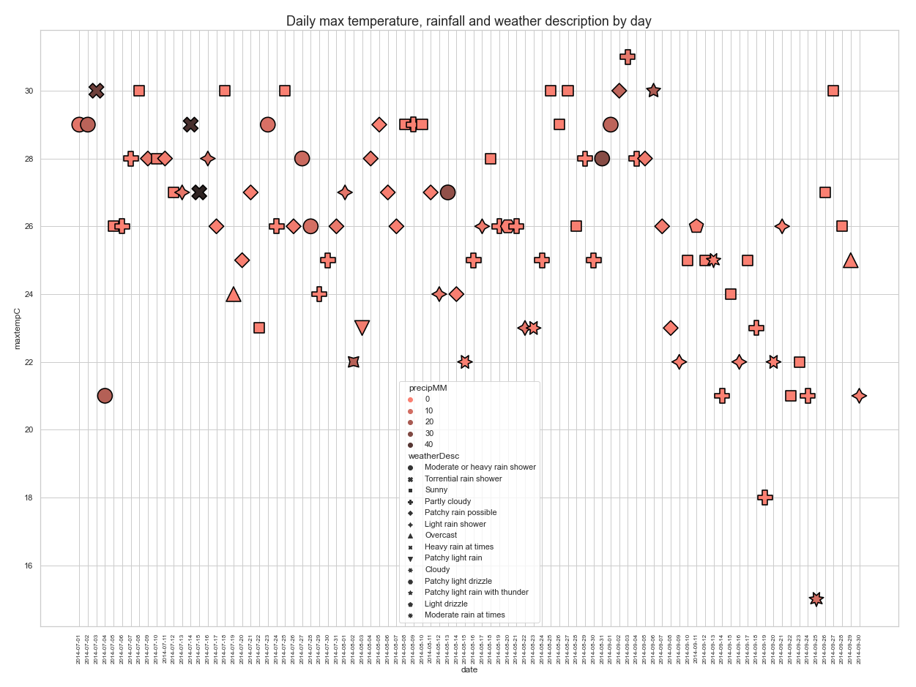
Details of the weather in New York between 1 July and 30 September 2014
Plot of the weather data for New York between 1 July 2014 and 30 September 2014
Max temperature is shown on the y-axis, individual days on the x-axis
The symbols are colour coded by maximum rainfall in mm (precipMM) and the symbolised using the weather description for that day
The mean daily max temperature is 26.0
The median daily max temperature is 26.0
The highest daily max temperature is 31.0
The lowest daily max temperature is 15.0
July
August
September

Slide 5
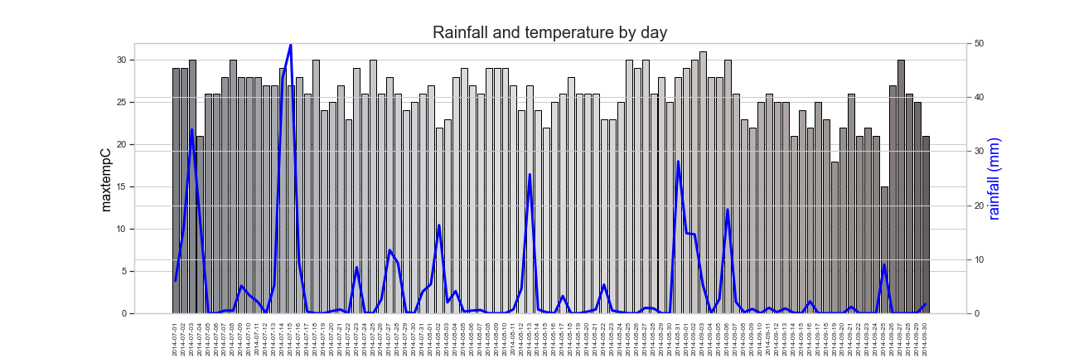
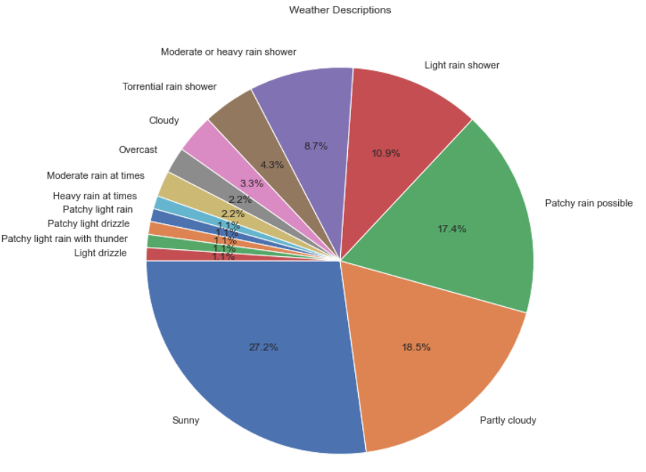
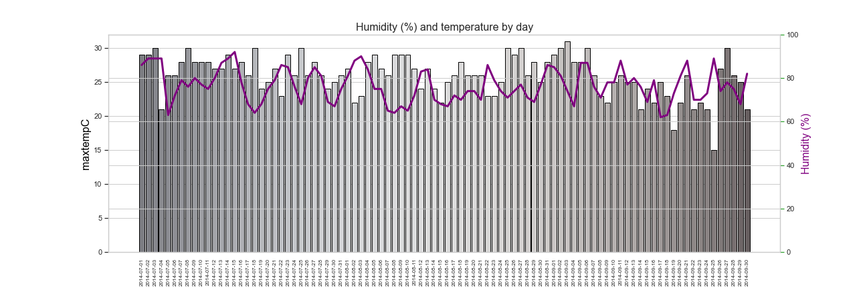
Details of the weather in New York between 1 July and 30 September 2014
Plot of max temperature vs rainfall
Shows ….
The mean daily rain is 4.425
The median daily rain is 0.5
The highest daily rain is 49.7
The lowest daily rain is 0.0
Plot of…..
Shows 53.2% of days had no rain
The mean daily humidity is 76.6
The median daily humidity is 76.0
The highest daily humidity is 92.0
The lowest daily humidity is 62.0
Plot of…..
Shows ….
Plot of…..
Shows ….
Notes:
This slide is to discuss the weather in new York over the period of interest

Slide 6
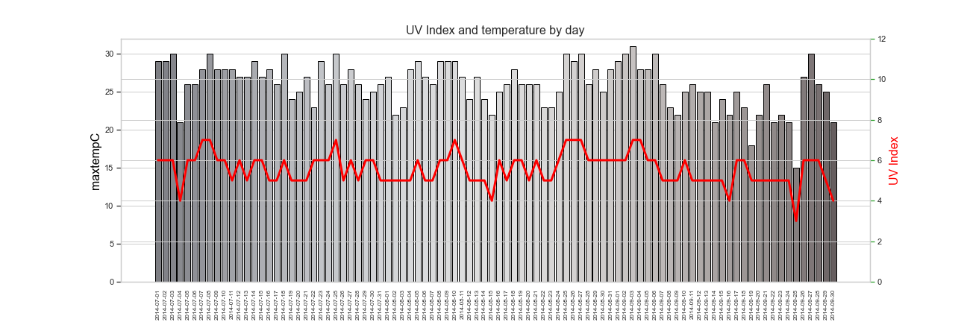
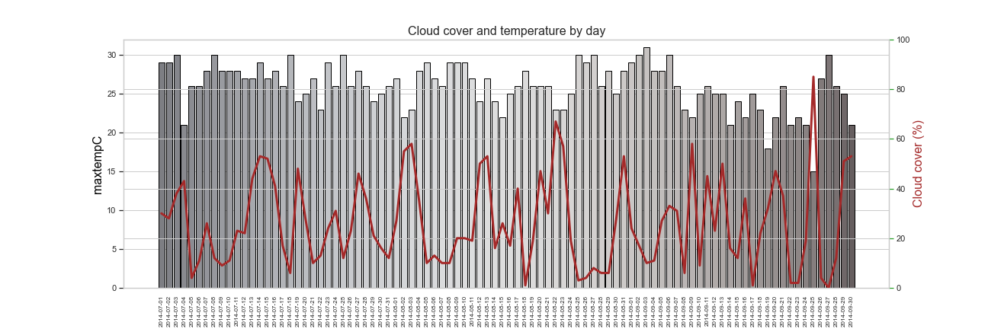
Details of the weather in New York between 1 July and 30 September 2014
Plot of max temperature vs rainfall
Shows ….
The mean daily uvIndex is 5.56
The median daily uvIndex is 6.0
The highest daily uvIndex is 7.0
The lowest daily uvIndex is 3.0
Plot of…..
Shows 53.2% of days had no rain
The mean daily cloud cover is 26.0
The median daily cloud cover is 22.5
The highest daily cloud cover is 85.0
The lowest daily cloud cover is 0.0
Plot of…..
Shows ….
Plot of…..
Shows ….
Notes:
This slide is to discuss the weather in new York over the period of interest

Slide 7
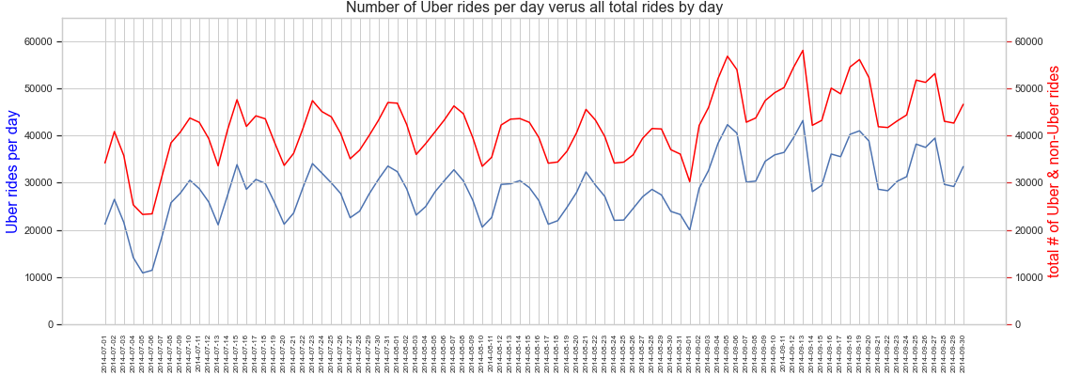
Details of the Uber and total rides (Uber and non-Uber FHV) in New York between 1 July and 30 September 2014
The mean daily # of Uber rides 28,842.73
The mean daily # of all rides 42,039.34
The highest daily number of Uber rides is 43,205
The lowest daily number of Uber rides is 10,890
What happens in early September 2014?
See weekday (5 day) – weekend (2 day) cyclicity in both the Uber rides and the total Uber and non-Uber FHV data

Slide 8
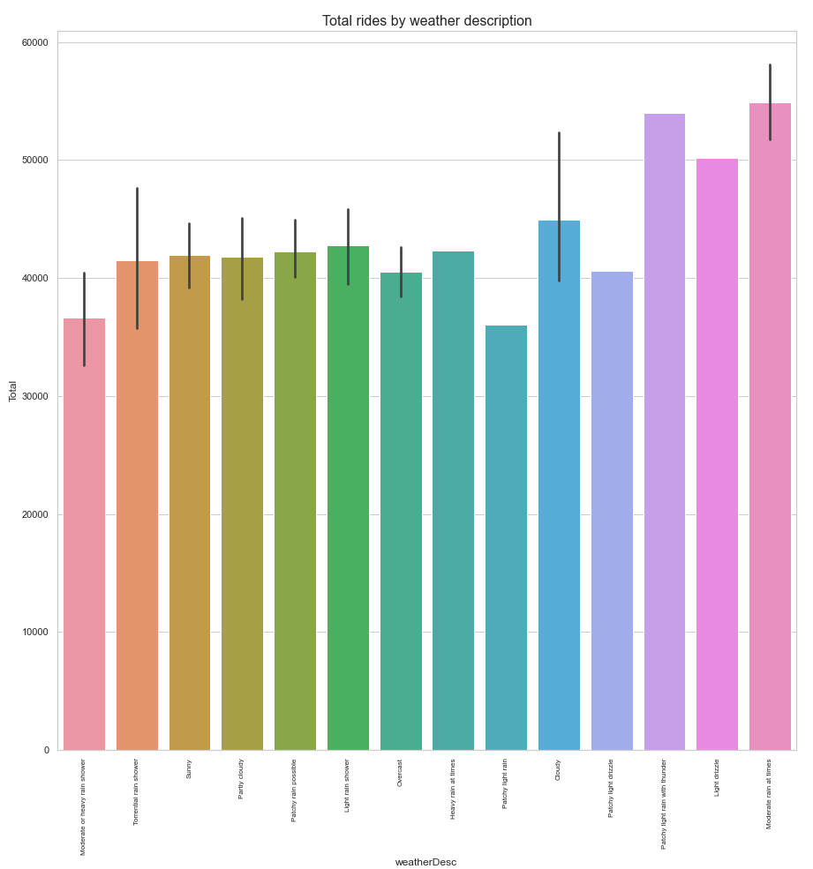
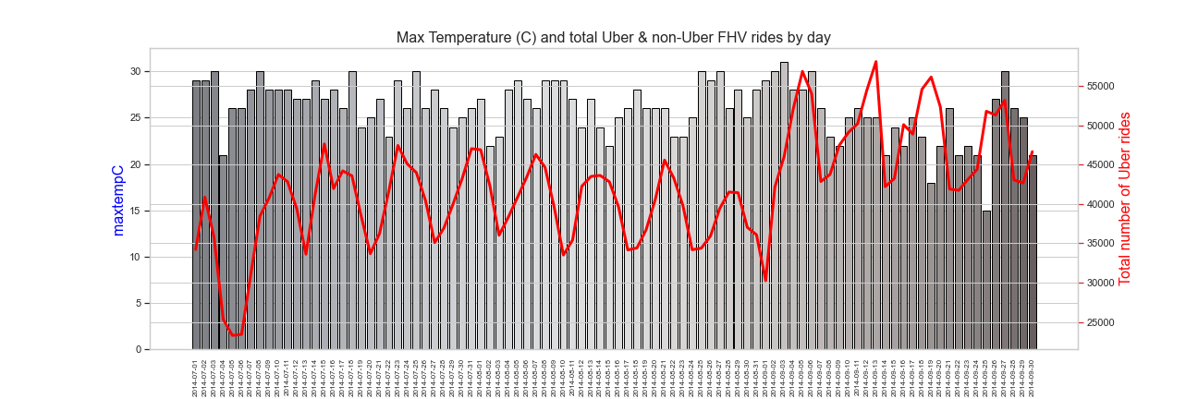
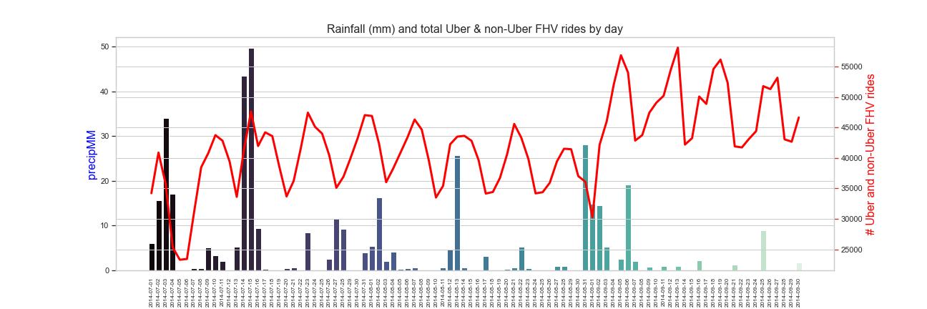
Details of the Uber and total rides in New York between 1 July and 30 September 2014 versus the weather
Plot of…..
Shows ….
Plot of…..
Shows ….
Plot of…..
Shows ….
Plot of…..
Shows ….
Plot of…..
Shows ….

Slide 9
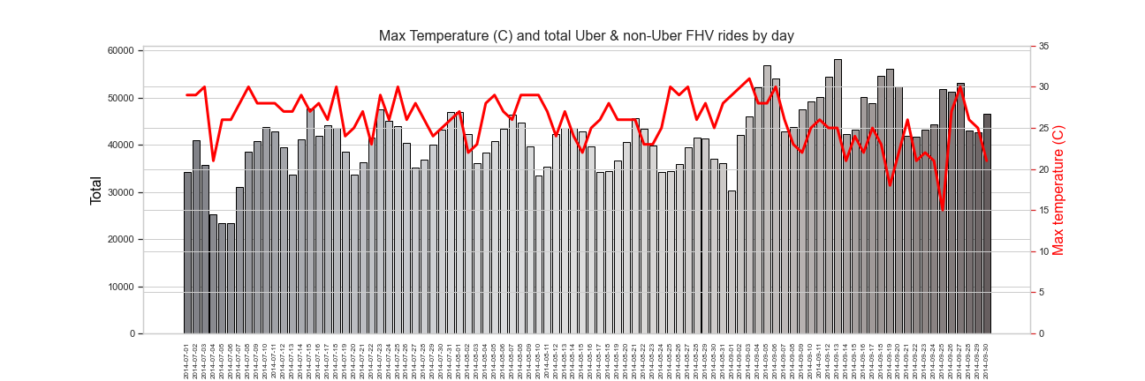
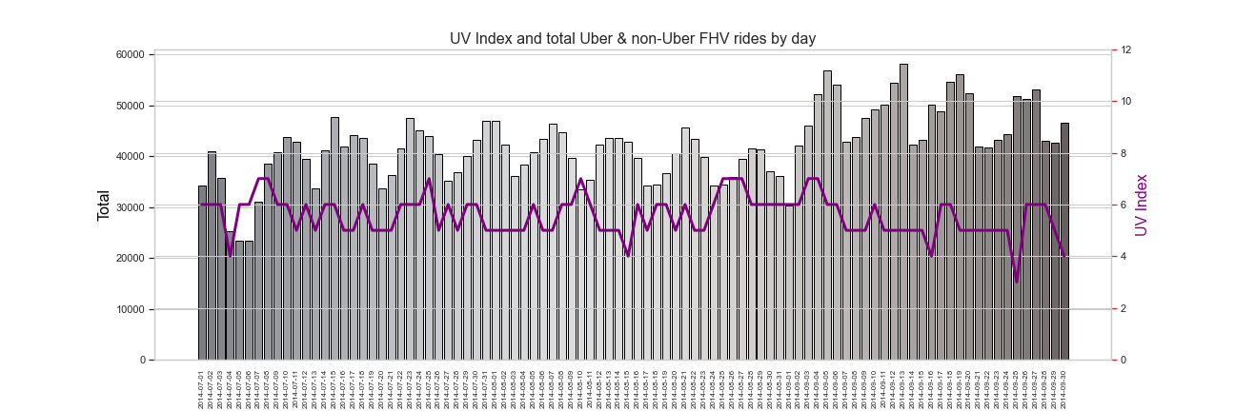
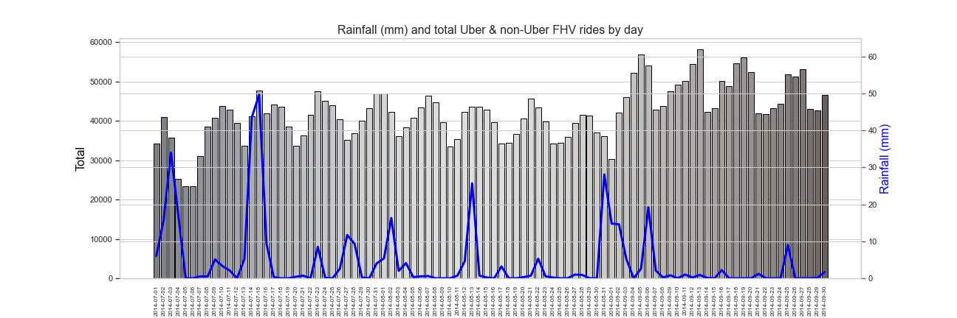
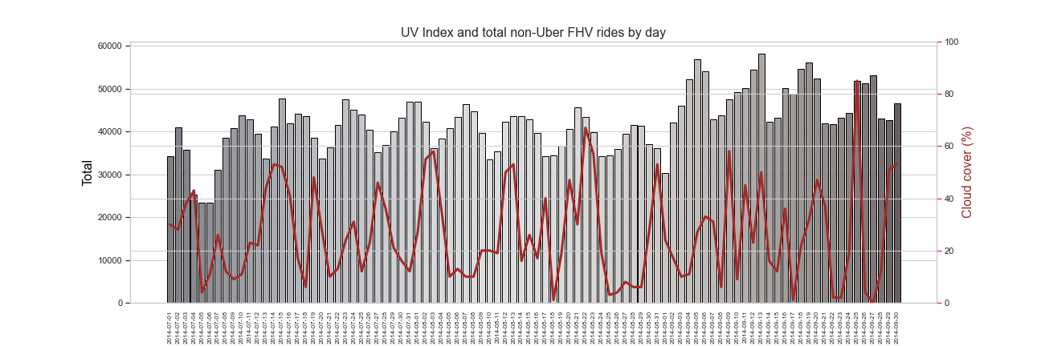
Details of the Uber and non-Uber FHV rides per day and weather in New York between 1 July and 30 September 2014
Plot of…..
Shows ….
Plot of…..
Shows ….
Plot of…..
Shows ….
Plot of…..
Shows ….
Plot of…..
Shows ….
These are plots of the total Uber and non-Uber rides per day against, max daily temperature, rainfall (mm), UV Index and cloud cover

Slide 10
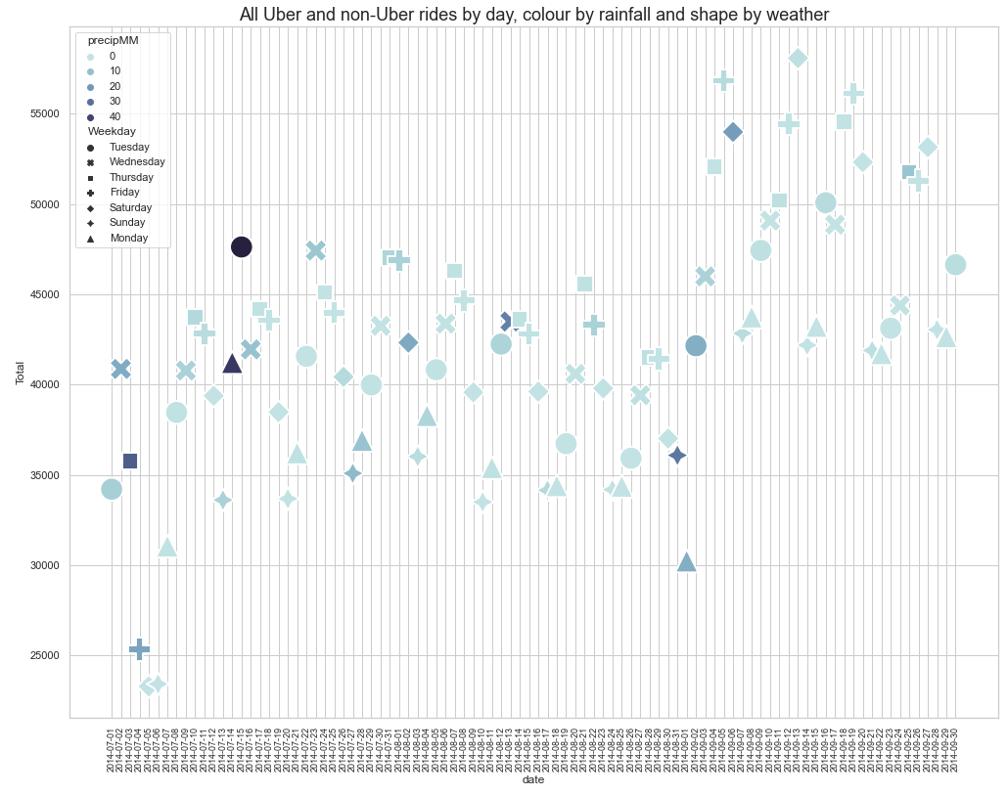
Total Uber & non-Uber FHV rides per day and rainfall in New York between 1 July and 30 September 2014
Plot of total rides by Uber & non-Uber FHV services between 1 July 2014 and 30 September 2014
The symbols are colour coded by rainfall (mm) and the symbolised using the day of the week
July
August
September

Slide 11
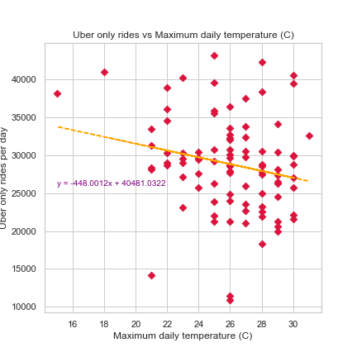
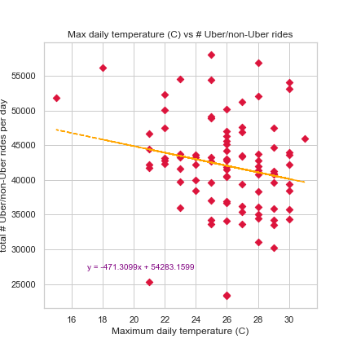
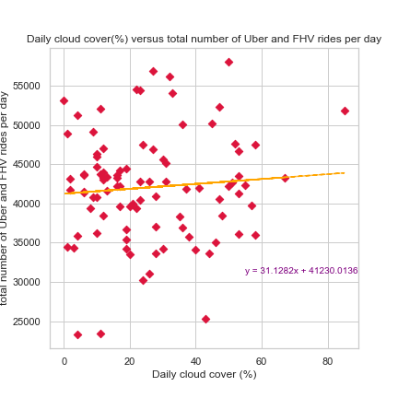
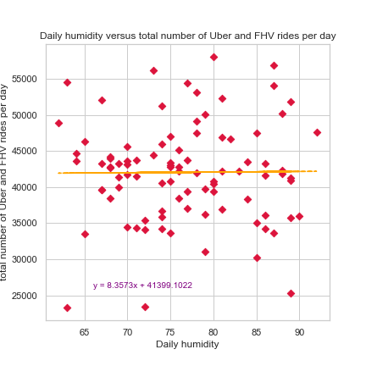
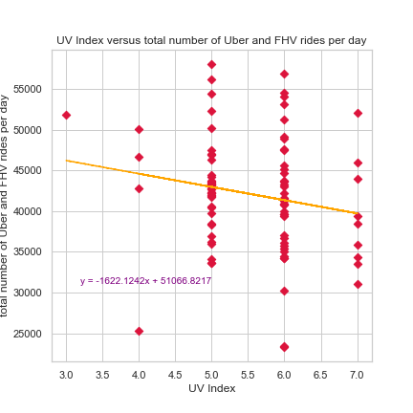
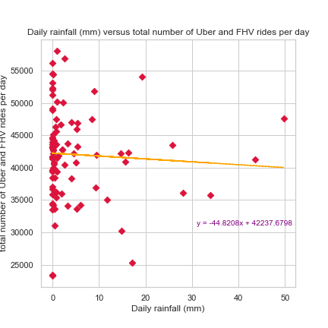
Statistical Analysis
Calculated correlation coefficient
Scatter plots with regression line
Conclusion from analysis
There is no correlation between number of daily rides and the weather for the time period investigated
Uber only rides vs max Temp
All rides vs max Temp
All rides vs cloud cover
The r correlation coefficient of max temp and total Uber only rides is r=-0.210
The r correlation coefficient of max temp and total rides is r=-0.204
The r correlation coefficient of cloud cover and total rides is r=0.082
All rides vs humidity
All rides vs UV Index
All rides vs rainfall
The r correlation coefficient of humidity and total rides is r=0.009
The r correlation coefficient of UV Index and total rides is r=-0.182
The r correlation coefficient of rainfall and total rides is r=-0.059

Slide 12
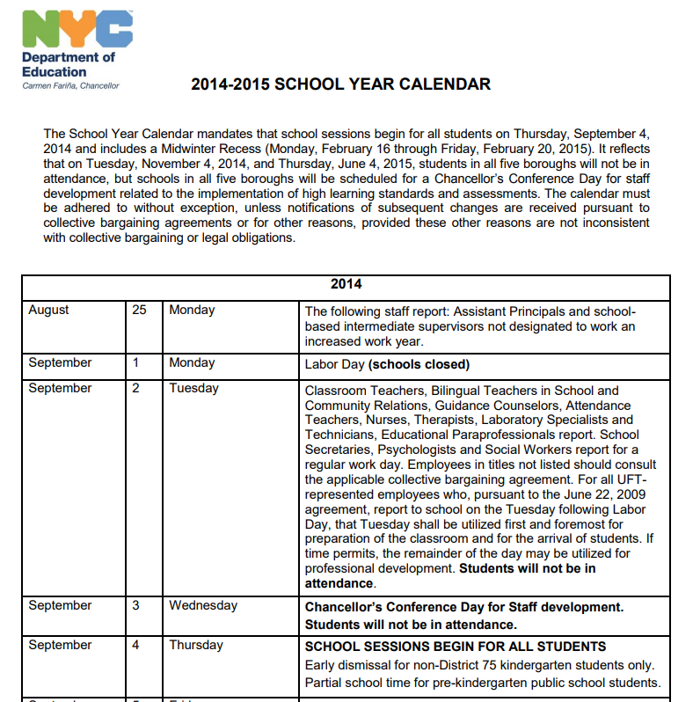
Why the increase in Total Uber & non-Uber FHV rides per day in early September 2014
School’s out…… no more
Just maybe not the weather but school’s back
American summer school includes July and August, school starts in September
https://www.nctq.org/dmsView/NYC_14-15_Calendar

Slide 13
Conclusions (just suggestions what do you think?)
No correlation between Uber/non-UberFHV rides and weather in time period
May be a product of not using a long enough time period
Increase in Uber rides in early September
Suggest this is a reflection of the end of school summer holidays with the start of 2014-2015 school term in NY on 4 September 2014
Things we could have improved upon / learnings:
Ff
Cc
Vv
dd

Slide 14
EXTRAS – OLD SLIDES
The graveyard

Slide 15
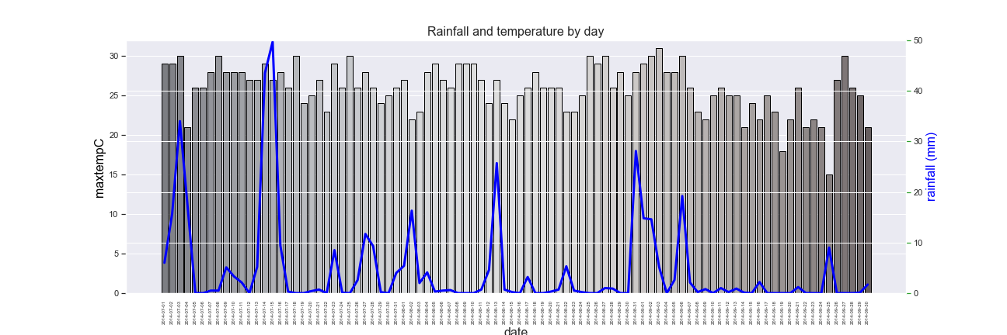
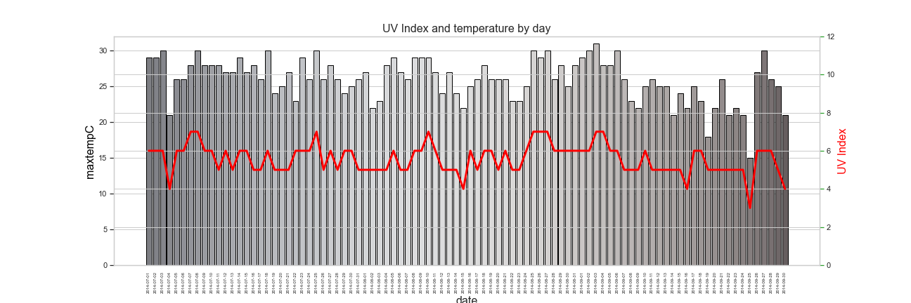
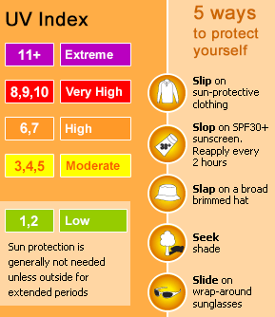

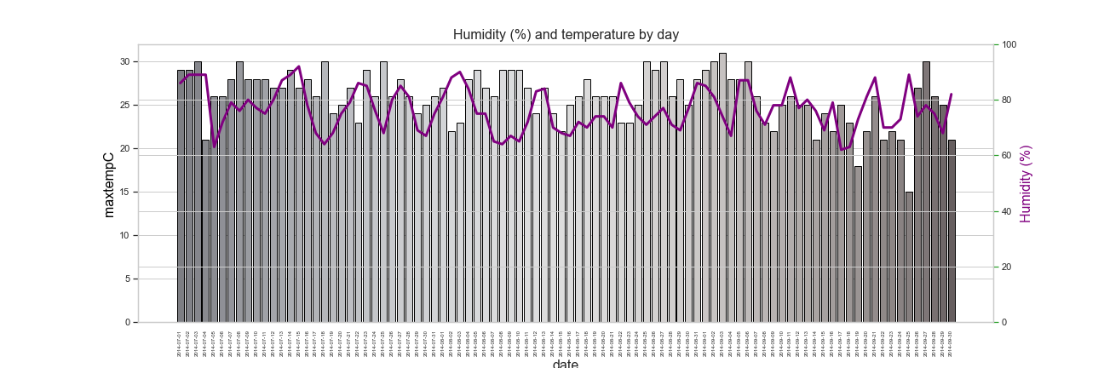
Details of the weather in New York between 1 July and 30 September 2014
Plot of max temperature vs rainfall
Shows ….
Plot of…..
Shows ….
Plot of…..
Shows ….
Plot of…..
Shows 53.2% of days had no rain
Plot of…..
Shows ….
Plot of…..
Shows ….
Notes:
This slide is to discuss the weather in new York over the period of interest

Slide 16
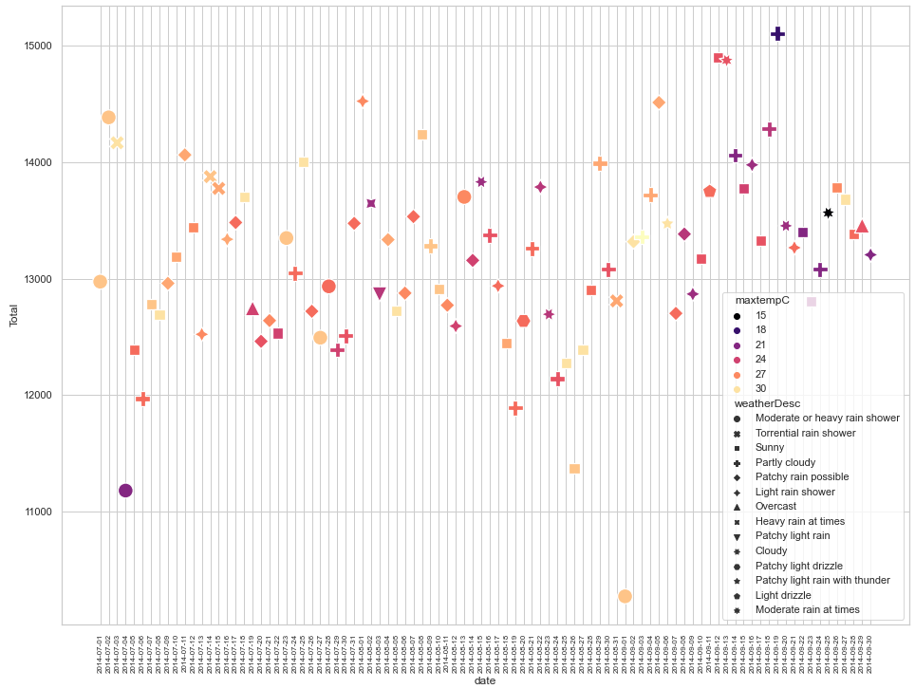
Total non-Uber FHV rides per day and weather in New York between 1 July and 30 September 2014
Plot of total rides by non-Uber FHV services between 1 July 2014 and 30 September 2014
The symbols are colour coded by maximum temperature (C) and the symbolised using the weather description for that day

Slide 17
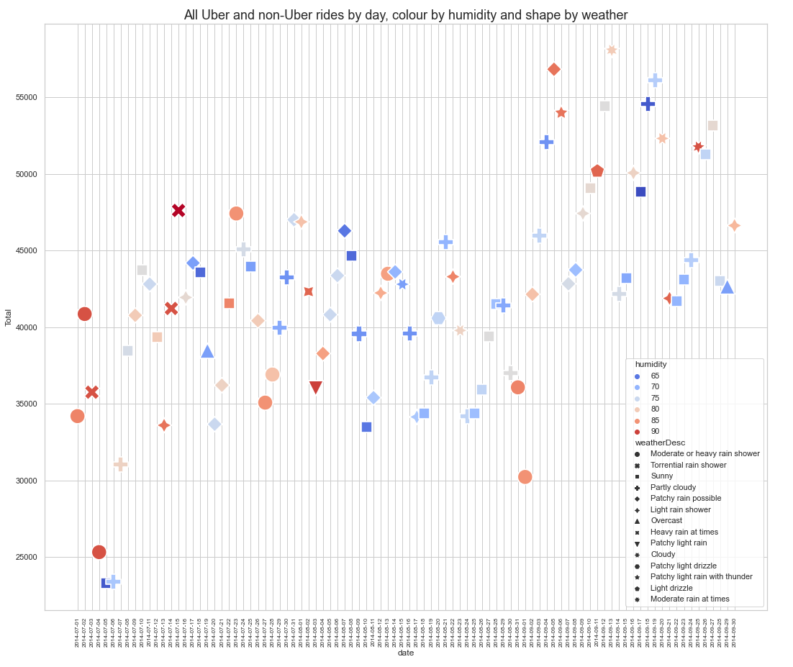
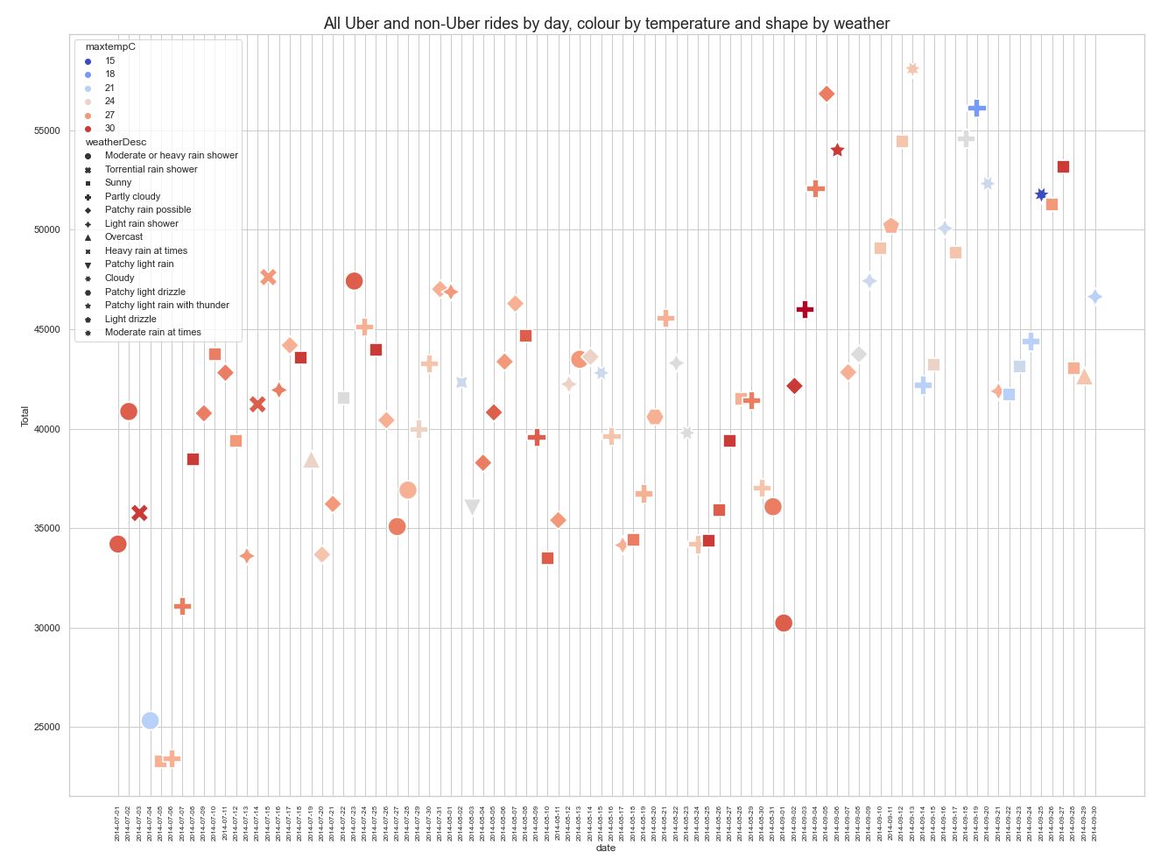
Total Uber & non-Uber FHV rides per day and weather in New York between 1 July and 30 September 2014
What happens after the 4th September 2014?
What happens after the 4th September 2014?

Slide 18
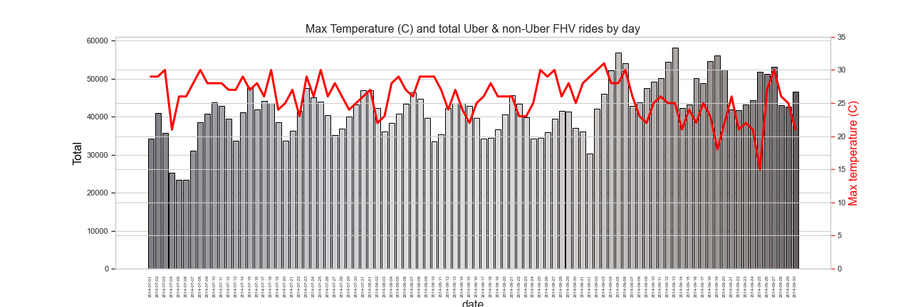
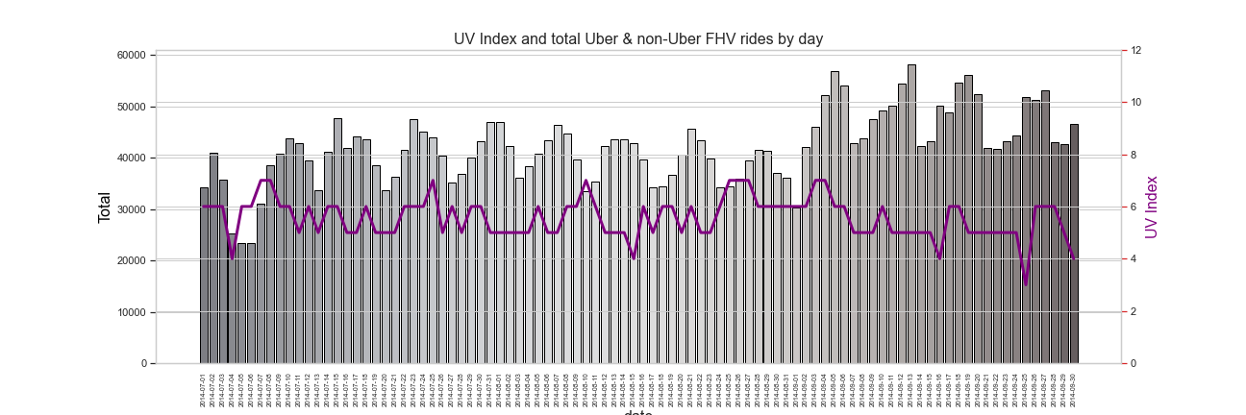
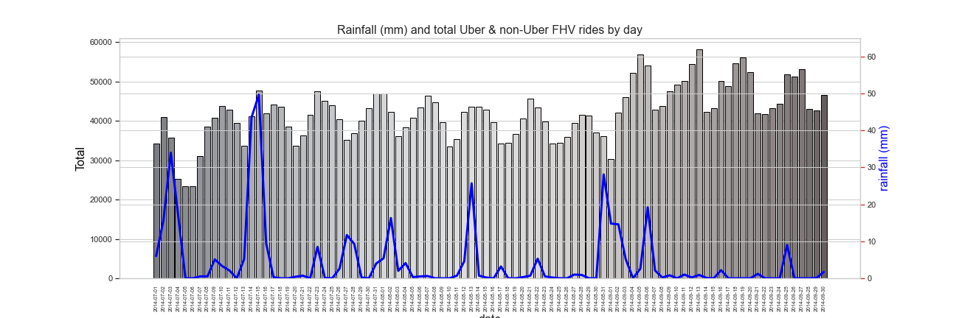

Details of the Uber and non-Uber FHV rides per day and weather in New York between 1 July and 30 September 2014
Plot of…..
Shows ….
Plot of…..
Shows ….
Plot of…..
Shows ….
Plot of…..
Shows ….
Plot of…..
Shows ….

